Slide 1

Organizational Update
Prepared for:
Animal Services Advisory Board
October 17, 2025
Notes:
Good Morning Chair Duerr and Advisory Board members....

Slide 2

The 1st Call for Help: Animal Help Desk
When pet owners in crisis don’t know where to turn, the Animal Help Desk is there to listen, guide, and offer solutions. Whether it’s rehoming a pet, accessing resources, or getting advice, we’re helping families stay together and pets stay safe.
Key Stats (Q3 2025)
3,111 community contacts to the Help Desk
2,474 surrender requests fielded with empathy
41 hours average response time
10 days median wait time for surrender appointments
“Thanks to the Help Desk, I got the support I needed to keep my dog, and my peace of mind.”
–Jane S., Help Desk Caller
Notes:
Nevada Humane Society has a contractual obligation to accept all owned pets living within Washoe County.
We provide a safety net to these animals when owners can no longer care for them
The requests for help come in 24 hours a day and our help desk team work diligently to offer assistance
As you can see the sheer number of requests are staggering.

Slide 3

As the designated surrender agency for Washoe County, Nevada Humane Society provides a compassionate safety-net for pets who have nowhere else to go. We’re here for the tough cases: the pets whose families are facing housing insecurity, financial hardship, illness, or crisis.
734
2,017
Q3 Surrenders
Year-to-Date Surrenders
Notes:
In QTR 2 we accepted 647 animals into our organization from community members. The majority of these animals needed some level of medical support, behavioral support – or both.

Slide 4
Partnership in Action: Transfers from WCRAS
Our partnership with Washoe County Regional Animal Services is the cornerstone of lifesaving in our community.
Every animal transferred from WCRAS into our care represents a coordinated effort to give pets the best possible outcome, whether that’s medical treatment, foster care, or a new beginning through adoption.
Notes:
When animals complete their stray hold at Washoe County Regional Animals Services and have not been reclaimed they are available to transfer out. This slide represents the percentage of those animals that NHS took in Q3.

Slide 5
Year-to-Date Transfers from WCRAS
Notes:
And this represents our year to date percentage of animals transferred from WCRAS

Slide 6
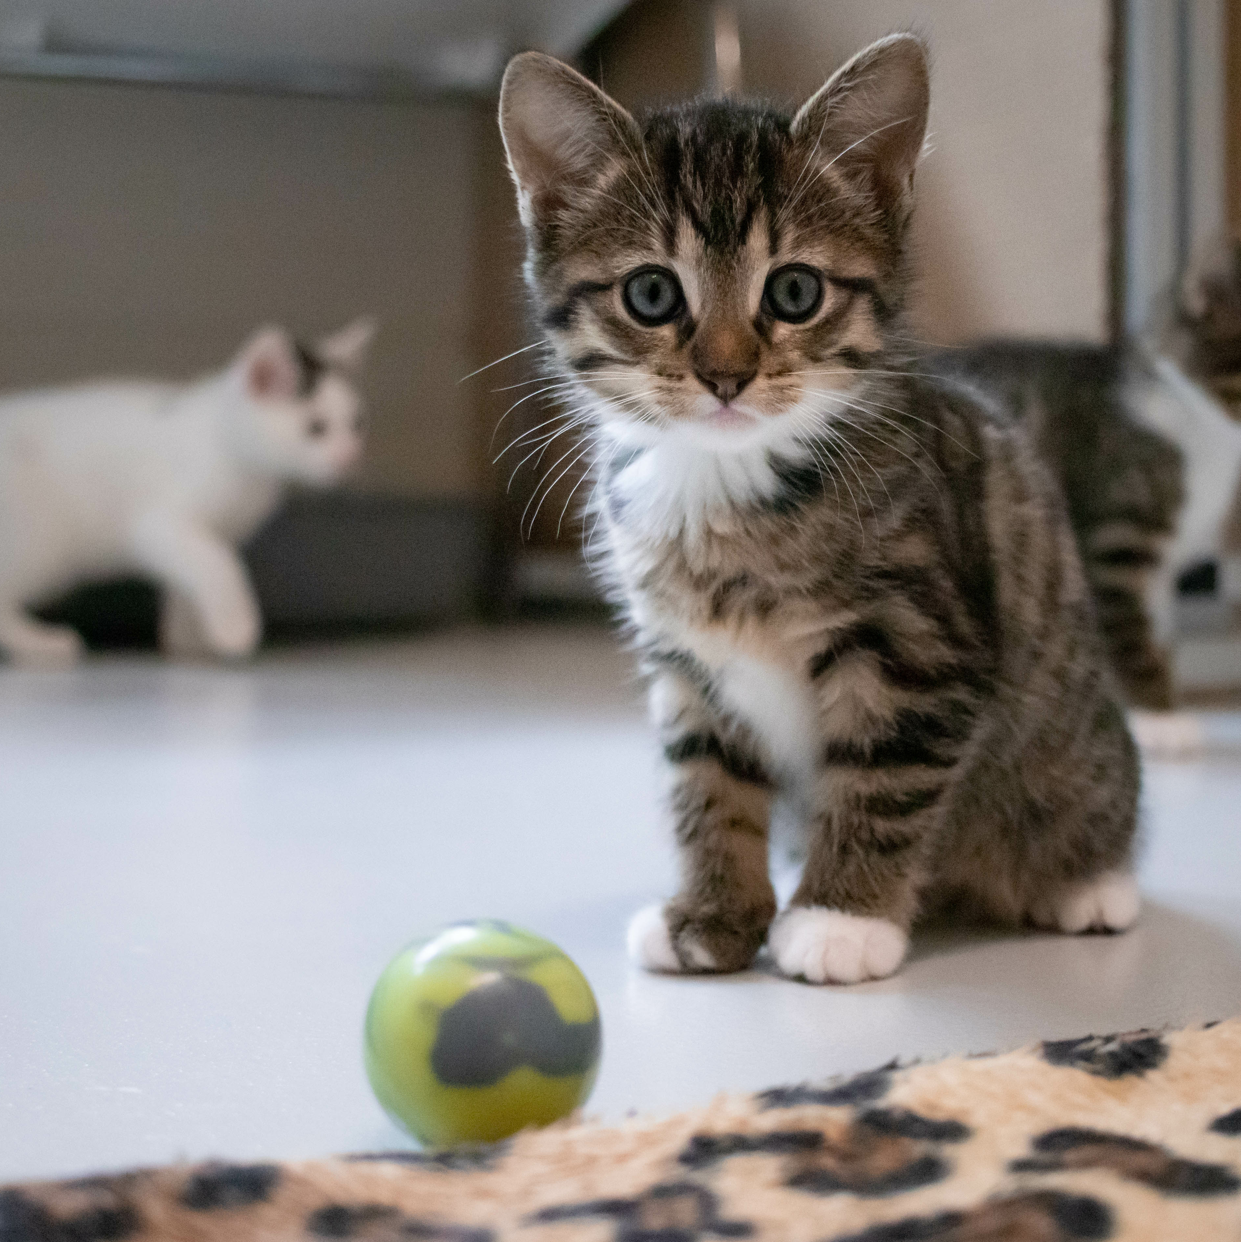
Tiny but Mighty: Good Samaritan Surrenders
Every spring, our community sees an influx of fragile kittens, orphaned, underweight, and too young for adoption.
Nevada Humane Society is proud to be the safety-net for these tiny lives. We accept any kittens under 2 lbs. so they can bypass the shelter environment and enter loving foster homes, where they grow strong and social, ready for forever families.
Key Stats:
701 Q3 Good Samaritan Surrenders
552 2024 Q3
1,349 Year-To-Date Good Samaritan Surrenders
1,099 2024 Total
Notes:
If you are not in animal welfare the term "kitten season" likely does not mean much. For those of us in animal welfare it carries significant weight. We prepare for it like we are going into battle. In March tiny babies trickle in our front doors being delivered by community members who have found them. By June it is no longer a trickle and they are steadily pouring in.

Slide 7
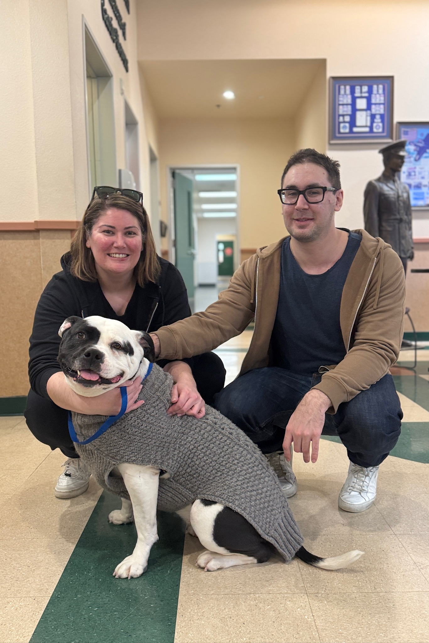
2,636
Q3 Total Intakes
734
1,115
Intakes – Surrender
Intakes – WCRAS Transfer
701
86
Intakes – Good Samaritan
Intakes – Other
Notes:
As you see on this slide we have accepted 2,662 animals into our Reno campus in Q3

Slide 8

2025 Year-To-Date Intakes
6,865
2,285
2,961
Intakes – Surrender
Intakes – WCRAS Transfer
1,421
207
Intakes – Good Samaritan
Intakes – Other
Notes:
And year to date over 4,000 animals. Many needing resources above and beyond what many organization would be able to provide came through our doors.

Slide 9
Happiness From Nose to Tail
The thousands of pets each year just like him, are why we do what we do: creating happiness from nose to tail for pets and the people who love them.
2,477
5,880
Q3 Adoptions
Year-to-Date Adoptions
2,442
5,659
Q3 2024 Adoptions
2024 Year-to-Date Adoptions
Notes:
This is always a happy number to be able to share. In just the first 6 months of this year 3,403 animals were placed into what we hope is their forever home.

Slide 10




Low-Cost. High-Impact.
Q3 Public Spay/Neuter Services
Our public spay & neuter program is one of the most effective ways we prevent unwanted litters, reduce shelter intake, and support our community. By making these services accessible and affordable, we’re helping people care for their pets — and keeping more animals out of the shelter.
323
955
1,278
Dog Spay & Neuter Surgeries
Cat Spay & Neuter Surgeries
Total Public Surgeries
Notes:
Our community medicine team was fully formed in May so we are pretty happy with almost 1300 surgeries being performed on owned animals in our community. Appointments are available 6 days a week and we are doing our best to shout this from the rooftop.
Regular posting on our social media
Regularly included in our e-news
Flyers in several local pet stores
Partnering with local trainers, vets, pet businesses and boarding facilities to include information in their e-news letters and hand out flyers
Calling our vaccine clinic attendees who have unsterilized pets to urge them to schedule
Flyers with every bag of pet pantry food
Paid Advertising:
Google Advertising ($10,000 per month—we don’t actually pay this, it is covered by our Google Ad Grant, but this is the value per month)
Microsoft Advertising ($3,000 per month, we don’t actually pay this, it is covered by our Google Ad Grant, but this is the value per month)
Nextdoor Advertising ($310 per month)
Meta (Facebook & Instagram) Advertising ($300 per month)

Slide 11
In addition to spay & neuter services, we provide low-cost vaccines and microchips to help keep owned pets healthy, safe, and home where they belong. These services are vital for families who want to do right by their pets but may be facing financial barriers.
Protecting Pets, Supporting People
1,741
3,073
5,876
Animals Microchipped in Q3
Animals Vaccinated in Q3
Vaccine Doses in Q3
Notes:
In Q3......

Slide 12

Volunteers: The Power of Showing Up
Volunteers are the heart of our mission — walking dogs, cuddling kittens, supporting events, and so much more. Their time and compassion make lifesaving possible every single day.
Key Stats
Q3 2025
7,423 Total Volunteer Hours
Equivalent to 16 Full Time Staff
Year-to-Date
21,499 Total Volunteer Hours
Notes:
Our volunteers are essential to Nevada Humane Society. The time that they generously contribute makes a significant impact on our staff and improves the lives of the animals we care for.

Slide 13
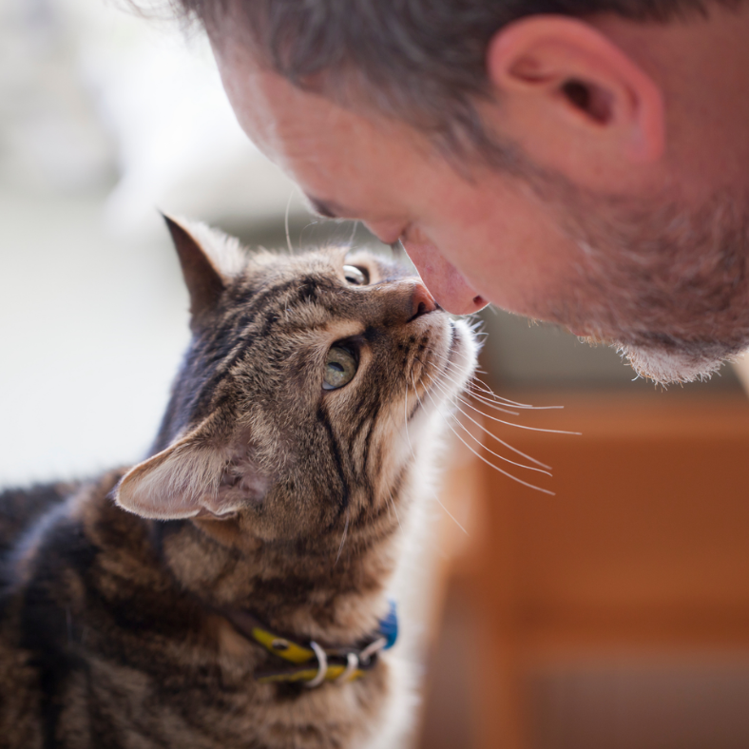
Fostering: Lifesaving Starts at Home
When space is tight or a pet needs extra care, foster families step in. From bottle babies to recovery cases, fostering gives pets the time, comfort, and love they need to thrive.
1,103 Placements in Q3
2,503 Placements Year-to-Date
Notes:
A very small but might team of 2 people are responsible for getting all of these animals, most of which are kittens out into foster homes.
Shout out to fosters....
Last year over 2500 animals into foster....

Slide 14

Full Bowls, Full Hearts
Our Pet Pantry helps keep pets where they belong, at home, with the families who love them. By providing free pet food and supplies to those in need, we’re preventing surrender and supporting pet owners through tough times.
Key Stats
Q3 2025
45,490 lbs. of Food
1,931 Dogs Fed
2,224 Cats Fed
Year-to-Date
145,600 lbs. of Food
6,181 Dogs Fed
8,800 Cats Fed
Notes:
One of the programs we have to support those struggling in our community......

Slide 15

Notes:
Thank you...

